Slide 1


Slide 2
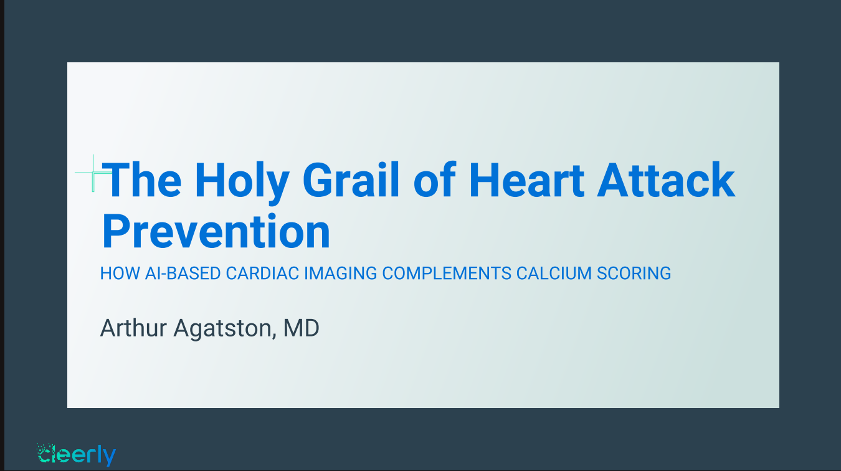

Slide 3


Carbon Dating vs. Plaque Dating
Notes:
Fossils

Slide 4
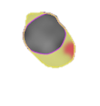


Plaque Dating-The Future of Coronary Imaging and Prevention
Fat
5 Years
15 Years
Calcium
Scar
Notes:
Joseph

Slide 5
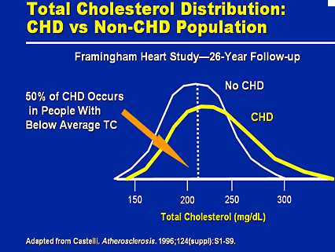

Slide 6
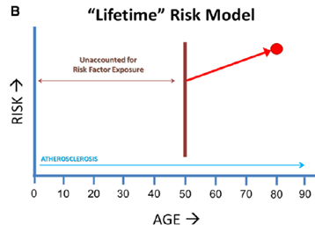
Dose/Duration of Risk Factor Exposure
= Total Plaque Burden
Lifetime Risk
Longer Risk Factor Exposure = Higher Risk
FH
Lp(a)
PCSK9
One Time Lipid
Measurement
LDL/WT
Genetic
Continuous
Exposure
Blaha, M. Circ Cardiovasc Imaging. 2014;7:398-408
Notes:
Really interested in lifetime risk—not 5 or 10 yr—Big problem in decisions re early rx due to lack of longterm clinical trials---must use a risk benefit ratio—example of Defranzo—triple therapy vs. insulin in EPIC trial on beta cell function and insulin sensitivity—EPIC trial—on Diabetics—great results but can’t do such a trial on pre prediabetics—not responsive to diet and exercise

Slide 7
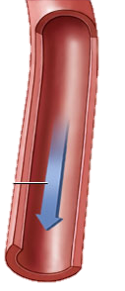
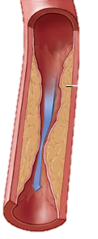
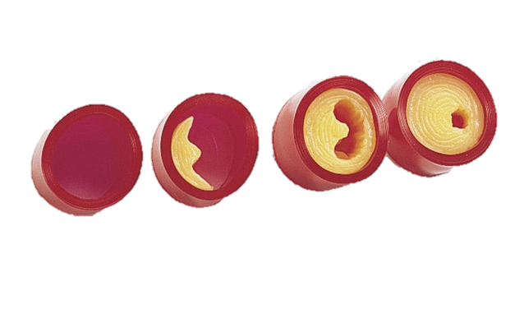

Traditional View of CAD
“The Big One”

Slide 8
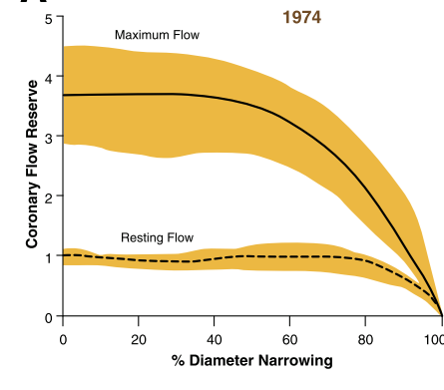
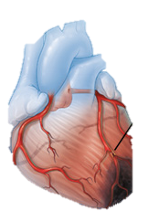
Physiologic Basis for Assessing Critical Coronary Stenosis-Canine Model
“The Big One”
K. Lance Gould Am J Cardiol 1974;33:87-94
Notes:
Figure 2. Experimental Versus Clinical Stenosis Severity
(A) Coronary flow reserve versus arteriographic percent diameter stenosis in canine experimental model. Adapted, with permission, from Gould et al. (1). (B) Coronary flow reserve in open-chest humans at bypass surgery versus arteriographic percent diameter stenosis. Solid or open circles or squares indicate different coronary arteries. Reproduced, with permission, from White et al. (12). RCA ? right coronary artery;
Quantitative hemodynamic assessment of coronary stenosis has not been previously reported. Resting coronary blood flow and its regional distribution are insensitive indexes for determining critical stenosis, but flow response to a hyperemic stimulus quantifies restrictions on maximal flow due to coronary arterial lesions. Coronary flow responses to temporary occlusion and to selective main coronary arterial injection of sodium diatrizoate (Hypaque-M 75 percent) were studied in 12 consecutive dogs with a surgically implanted electromagnetic flowmeter and separate micrometer constrictor on the left circumflex coronary artery. Selective Hypaque injection adequate for coronary cineangiography increased coronary flow to four times the resting base-line value, peaking at 6 seconds and lasting 3 minutes, a response equivalent to hyperemia after 10 seconds of circumflex arterial occlusion. With progressive micrometer constriction, resting flow measurements did not decrease until there was 65 percent stenosis. Hyperemia after intracoronary injection of Hypaque decreased when there was 30 to 45 percent stenosis and disappeared when there was 66 to 93 percent stenosis. Myocardial images obtained by gamma camera after left atrial injection of 131iodine-macroaggregated albumin demonstrated uniform regional distribution of resting flow in spite of severe constriction. However, 6 seconds after selective Hypaque injection, left atrial injection of ggmtechnetium macroaggregates demonstrated distinct perfusion abnormalities in the region of circumflex stenosis. Thus, flow distribution with a severe lesion was normal at rest but showed marked differences due to restricted circumflex versus normal anterior descending hyperemic response after injection of Hypaque. Flow response and regfonal distribution during coronary hyperemia caused by Hypaque are quantitative measures for physiologically assessing critical coronary stenosis and flow reserve with potential applicability to patients.

Slide 9
Did This Approach Prevent Heart Attacks?
NO!!!
The Proof

Slide 10
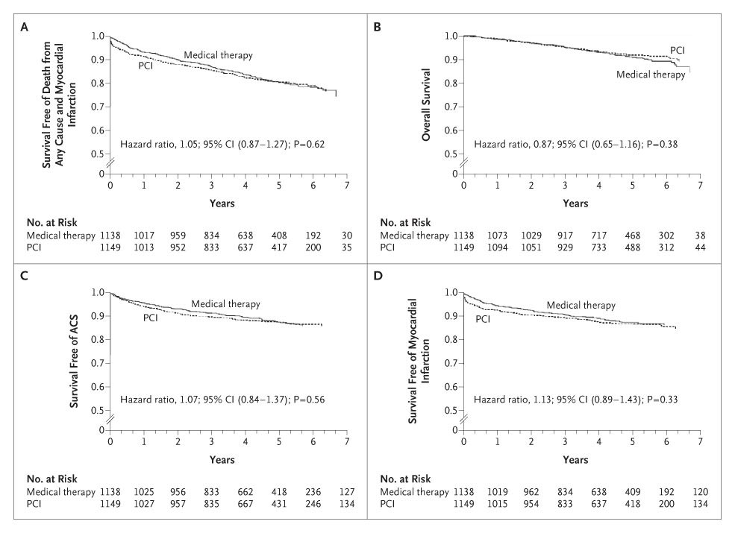



The Courage Trial-Stents vs. Medical Therapy
Statin
Stent
No Difference
Boden W et al. N Engl J Med 2007;0:NEJMoa070829v1-1
Notes:
10
Figure 2. Kaplan-Meier Survival Curves. In Panel A, the estimated 4.6-year rate of the composite primary outcome of death from any cause and nonfatal myocardial infarction was 19.0% in the PCI group and 18.5% in the medical-therapy group. In Panel B, the estimated 4.6-year rate of death from any cause was 7.6% in the PCI group and 8.3% in the medical-therapy group. In Panel C, the estimated 4.6-year rate of hospitalization for acute coronary syndrome (ACS) was 12.4% in the PCI group and 11.8% in the medical-therapy group. In Panel D, the estimated 4.6-year rate of acute myocardial infarction was 13.2% in the PCI group and 12.3% in the medical-therapy group.

Slide 11
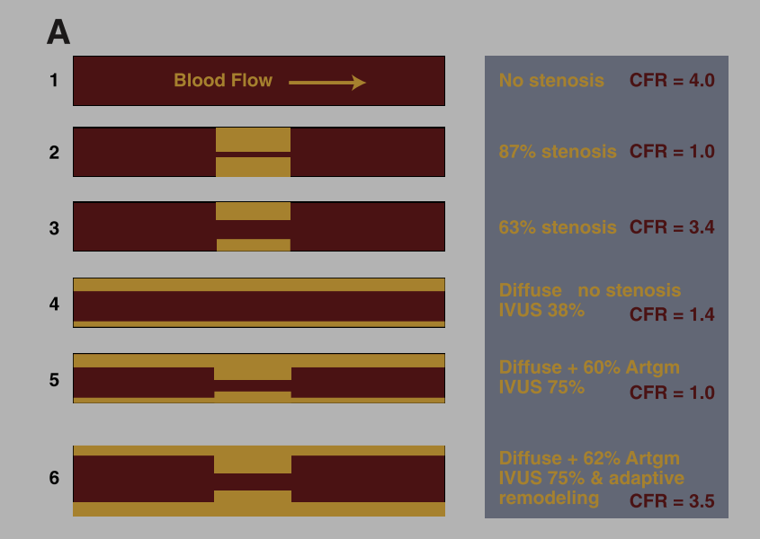
Coronary Function Versus Anatomy:
With Diffuse Coronary Artery Disease and Remodeling
K. Lance Gould J Am Coll Cardiol 2009;2:1009–23
Glagov S, N Engl J Med. 1987; 316: 1371–1375.
Notes:
Figure 4. Coronary Function Versus Anatomy With Diffuse Coronary Artery Disease and Remodeling
(A) Schematic illustrating limitations of anatomic measures of stenosis severity by arteriogram (Artgm) or intravascular ultrasound (IVUS) due to diffuse disease with and without remodeling compared to coronary flow reserve. (B) For the schematic arteries illustrated in A,a scatter plot of coronary flow reserve (CFR) versus percent diameter stenosis (%DS) by arteriogram (brown diamonds) and by IVUS (yel- low circles). The numbers beside each point of the scatter gram correspond to the numbered schematic examples of A.
Although

Slide 12
Coronary Function Versus Anatomy:
With Diffuse Coronary Artery Disease and Remodeling
K. Lance Gould J Am Coll Cardiol 2009;2:1009–23
Notes:
Figure 4. Coronary Function Versus Anatomy With Diffuse Coronary Artery Disease and Remodeling
(A) Schematic illustrating limitations of anatomic measures of stenosis severity by arteriogram (Artgm) or intravascular ultrasound (IVUS) due to diffuse disease with and without remodeling compared to coronary flow reserve. (B) For the schematic arteries illustrated in A,a scatter plot of coronary flow reserve (CFR) versus percent diameter stenosis (%DS) by arteriogram (brown diamonds) and by IVUS (yel- low circles). The numbers beside each point of the scatter gram correspond to the numbered schematic examples of A.
Although

Slide 13
Coronary Function Versus Anatomy: Dr. Glagov
With Diffuse Coronary Artery Disease and Remodeling
K. Lance Gould J Am Coll Cardiol 2009;2:1009–23
Glagov S, N Engl J Med. 1987; 316: 1371–1375.
Notes:
Figure 4. Coronary Function Versus Anatomy With Diffuse Coronary Artery Disease and Remodeling
(A) Schematic illustrating limitations of anatomic measures of stenosis severity by arteriogram (Artgm) or intravascular ultrasound (IVUS) due to diffuse disease with and without remodeling compared to coronary flow reserve. (B) For the schematic arteries illustrated in A,a scatter plot of coronary flow reserve (CFR) versus percent diameter stenosis (%DS) by arteriogram (brown diamonds) and by IVUS (yel- low circles). The numbers beside each point of the scatter gram correspond to the numbered schematic examples of A.
Although

Slide 14
Coronary Function Versus Anatomy With Diffuse Coronary Artery Disease and Remodeling
K. Lance Gould J Am Coll Cardiol 2009;2:1009–23
Notes:
Figure 4. Coronary Function Versus Anatomy With Diffuse Coronary Artery Disease and Remodeling
(A) Schematic illustrating limitations of anatomic measures of stenosis severity by arteriogram (Artgm) or intravascular ultrasound (IVUS) due to diffuse disease with and without remodeling compared to coronary flow reserve. (B) For the schematic arteries illustrated in A,a scatter plot of coronary flow reserve (CFR) versus percent diameter stenosis (%DS) by arteriogram (brown diamonds) and by IVUS (yel- low circles). The numbers beside each point of the scatter gram correspond to the numbered schematic examples of A.
Although

Slide 15
Coronary Function Versus Anatomy With Diffuse Coronary Artery Disease and Remodeling
K. Lance Gould J Am Coll Cardiol 2009;2:1009–23
Notes:
Figure 4. Coronary Function Versus Anatomy With Diffuse Coronary Artery Disease and Remodeling
(A) Schematic illustrating limitations of anatomic measures of stenosis severity by arteriogram (Artgm) or intravascular ultrasound (IVUS) due to diffuse disease with and without remodeling compared to coronary flow reserve. (B) For the schematic arteries illustrated in A,a scatter plot of coronary flow reserve (CFR) versus percent diameter stenosis (%DS) by arteriogram (brown diamonds) and by IVUS (yel- low circles). The numbers beside each point of the scatter gram correspond to the numbered schematic examples of A.
Although

Slide 16
Coronary Function Versus Anatomy:
With Diffuse Coronary Artery Disease and Remodeling
K. Lance Gould J Am Coll Cardiol 2009;2:1009–23
Notes:
Figure 4. Coronary Function Versus Anatomy With Diffuse Coronary Artery Disease and Remodeling
(A) Schematic illustrating limitations of anatomic measures of stenosis severity by arteriogram (Artgm) or intravascular ultrasound (IVUS) due to diffuse disease with and without remodeling compared to coronary flow reserve. (B) For the schematic arteries illustrated in A,a scatter plot of coronary flow reserve (CFR) versus percent diameter stenosis (%DS) by arteriogram (brown diamonds) and by IVUS (yel- low circles). The numbers beside each point of the scatter gram correspond to the numbered schematic examples of A.
Although

Slide 17
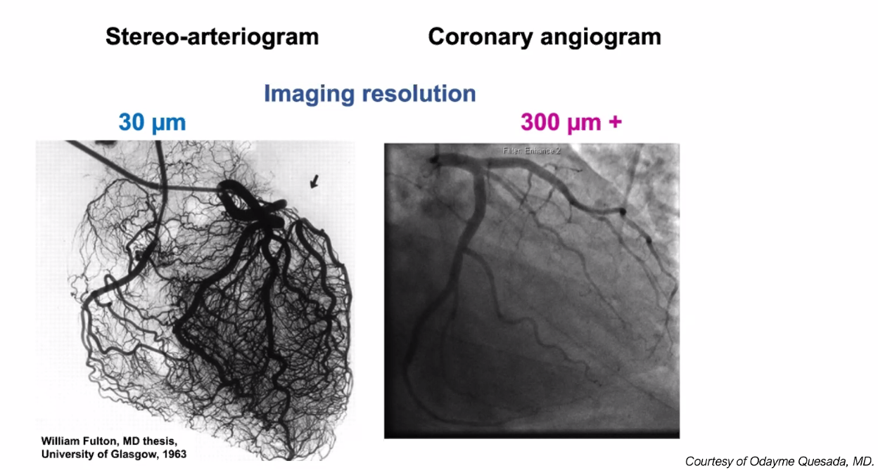
Collaterals Not Seen on Angiograms

Slide 18
The Formation of a Coronary Plaque and its Evolution

Slide 19
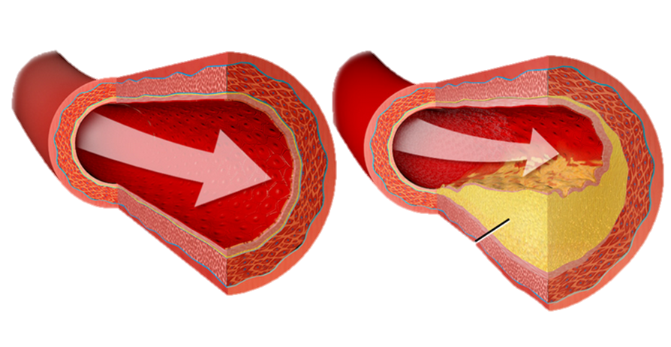
Lumen
Blood Clot
Plaque
Rupture
Scar Tissue
Calcium
Healed Plaques

Slide 20
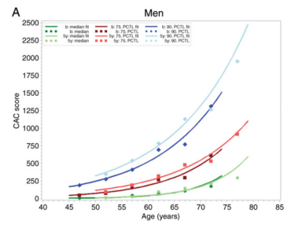
High Plaque Burden=Fast Athero Progression
Low Plaque Burden, Slow Progression
Heinz-Nixdorf RECALL CAC Trial European Heart Journal 2014:35; p. 2966

Slide 21
Why Does High Atherosclerotic Burden Accelerate Progression?
The Feed Forward Mechanism
of Atherosclerosis

Slide 22

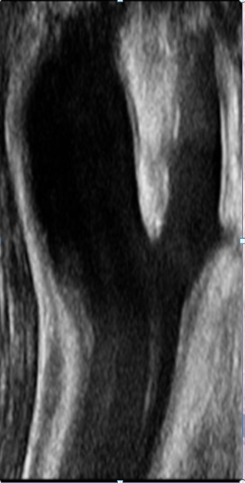
The Colorado River
Notes:
Laying down Silt vs. plaque

Slide 23
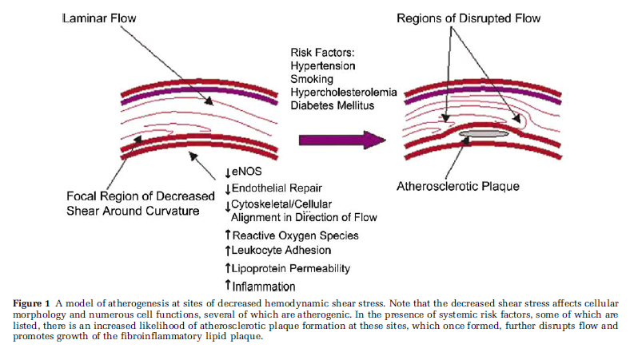
The role of shear stress in the pathogenesis of atherosclerosis
Cunningham, C. Laboratory Investigation (2005) 85, 9–23

Slide 24
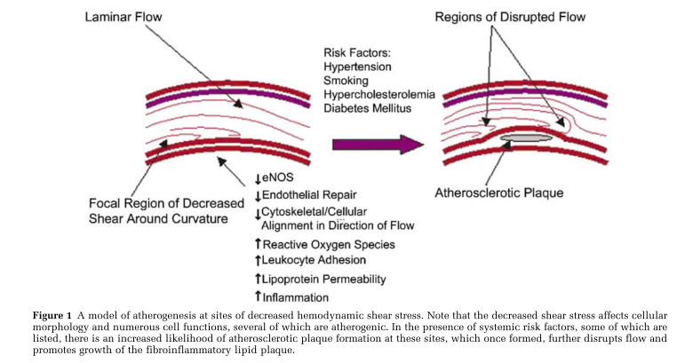
Feed Forward
Laboratory Investigation (2005) 85, 9–23 page 10

Slide 25
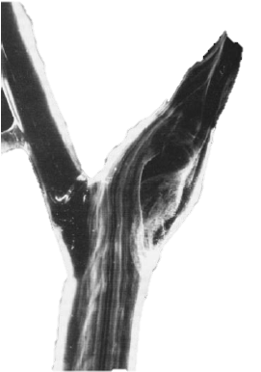
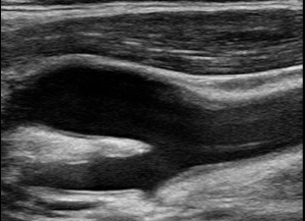
Carotid Flow
Rabbit Carotid with Microspheres
Human Carotid Artery
Disrupted
Flow
Laminar
Annu. Rev. Biomed. Eng. 1999. 01:299–329

Slide 26
LAD
Aorta

Slide 29
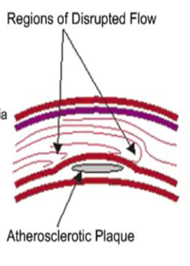

Slide 31
31

Slide 32
61

Slide 37
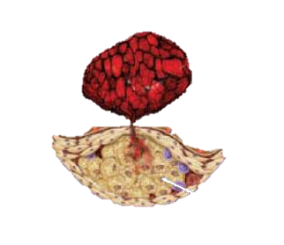
Vascular
Risk
Thrombogenic
Risk
Atherogenic
Risk

Slide 38
Effective Therapy
Stops Progression

Slide 39
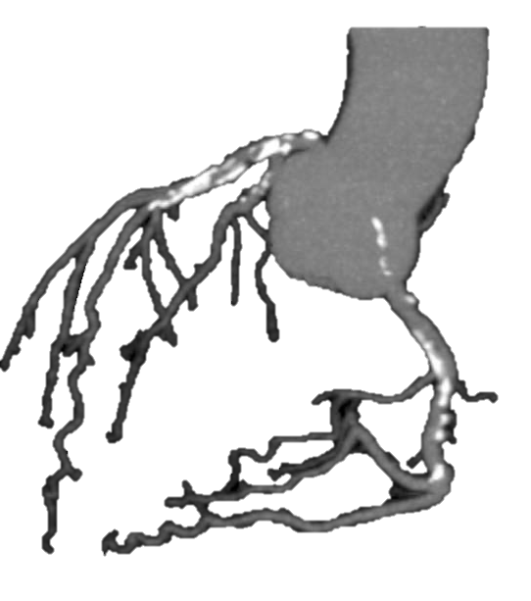
70 yo MD after 20 years of aggressive statin therapy
Notes:
PM--rx for many years---abrupt stop of CAC

Slide 40
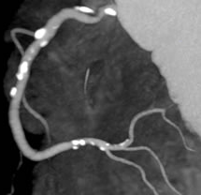
68 yo Lifelong Untreated Risk Factor Exposure

Slide 41
Plaque Dating/Plaque Age:
From Its Origin Through Its Maturity

Slide 42

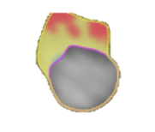





Plaque Progression/Age
Young Plaque
Cleerly AI
Old Plaque
Notes:
This slide illustrated the natural hx of calcified plaque

Slide 43
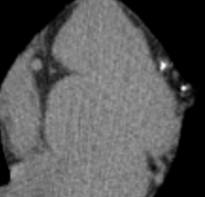
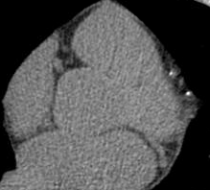
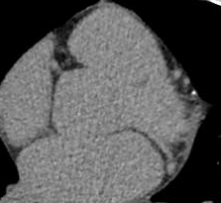
Serial CAC Scans Showing the
Natural History of Calcified Plaque
2022
2018
2016
Notes:
Amir Gold—young-FH only and lesion progression—for aggressive rx

Slide 44
Cleerly Natural History of Plaque Progression without Treatment
Fatty
Plaque
Post Rupture
Scar
6 mos→
2yrs
5-10 yrs
10-20 yrs
Notes:
This slide illustrated the natural hx of calcified plaque

Slide 45
47 yo WM with baseline Cleerly before Treatment with 5 year Follow-up Cleerly after Treatment

Slide 46
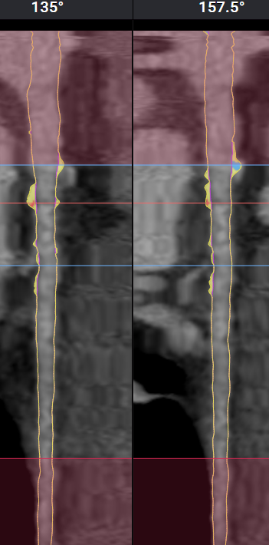
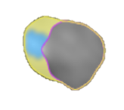
53 at age 47, CAC=138, +Family History CAD
2017-Before Treatment

Slide 47
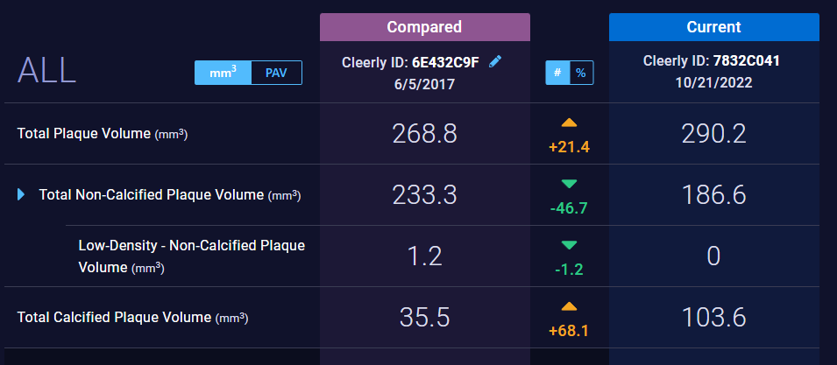
53 CAC=138
2017
2022
Notes:
JH=no fat, less scar, calcification

Slide 48
JH 47: Plaque Progression Over 5 yrs
2017
2022
Notes:
Joseph

Slide 49
53yo M
Very High TCs, High CAC, Noncompliant

Slide 50
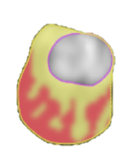
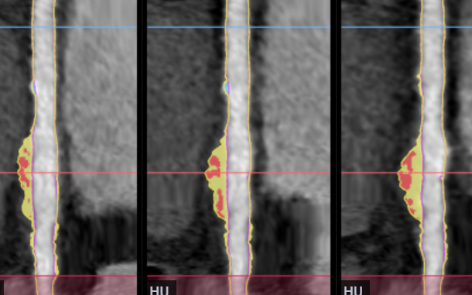
53, CAC=145
RCA
Notes:
OS 53

Slide 51
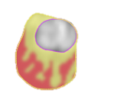
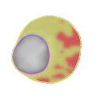
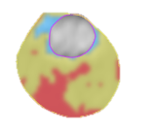
OS 53, CAC=145
RCA
5/10/24
11/8/23
5/8/23
Statin and PCSK9
Inhibitor started

Slide 52
76 M with CAD
Stents 2004, 08, 09 and 11
Notes:
RK-CACS=740 3/28/19, (excluding stents in prox. LAD, L circ, RCAlow HDL, TC never >220 mg/dl; sent to lipid specialist Dr. Jeffrey Boord at Vanderbilt 2006, 615-322-2318, d/c'd Zetia replaced with Niaspan 1,500 mg., cont. Lipitor 20 mg., also followed by Dr. A. Sabharwal at UM>9/08 changed from Lipitor to Crestor 10 mg. and inc. Niaspan to 3 Gm., added WelChol. KIF6 neg., 9p21 homozygous; Lp(a)-329 off niacin, ApoE=3/3

Slide 53
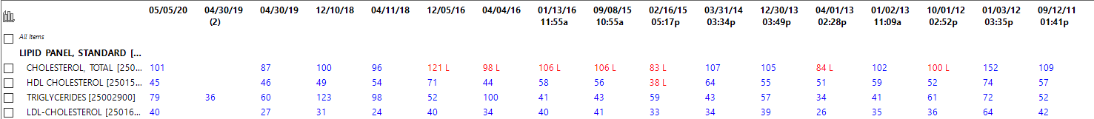
76 M, CAD-stents 2004, 08, 09 and 11
Chest Pain
Another Stent
Notes:
Rick Keister-CACS=740 3/28/19, (excluding stents in prox. LAD, L circ, RCAlow HDL, TC never >220 mg/dl; sent to lipid specialist Dr. Jeffrey Boord at Vanderbilt 2006, 615-322-2318, d/c'd Zetia replaced with Niaspan 1,500 mg., cont. Lipitor 20 mg., also followed by Dr. A. Sabharwal at UM>9/08 changed from Lipitor to Crestor 10 mg. and inc. Niaspan to 3 Gm., added WelChol. KIF6 neg., 9p21 homozygous; Lp(a)-329 off niacin, ApoE=3/3

Slide 54
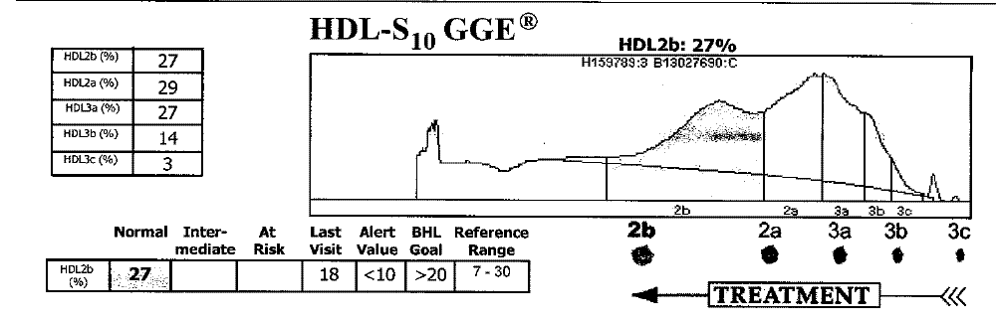
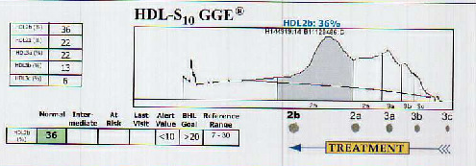
RK 76 M, CAD-stents 2004, 08, 09 and 11
Fenofibrate
4/5/13
9/16/11
Notes:
CACS=740 3/28/19, (excluding stents in prox. LAD, L circ, RCAlow HDL, TC never >220 mg/dl; sent to lipid specialist Dr. Jeffrey Boord at Vanderbilt 2006, 615-322-2318, d/c'd Zetia replaced with Niaspan 1,500 mg., cont. Lipitor 20 mg., also followed by Dr. A. Sabharwal at UM>9/08 changed from Lipitor to Crestor 10 mg. and inc. Niaspan to 3 Gm., added WelChol. KIF6 neg., 9p21 homozygous; Lp(a)-329 off niacin, ApoE=3/3

Slide 55


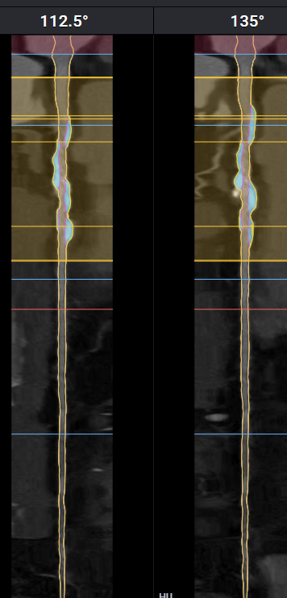
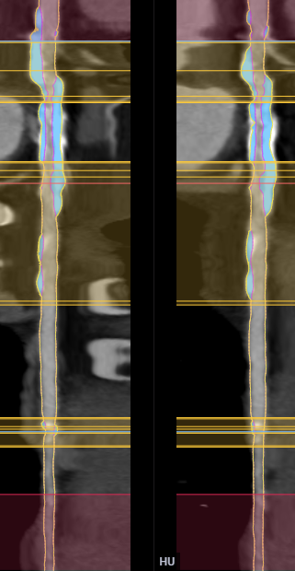

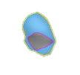
RK 76 M, CAD-stents 2004, 08, 09 and 11
→ Treatment for HDL dysfunction—No more symptoms
RCA
LAD
All Old Plaque

Slide 56
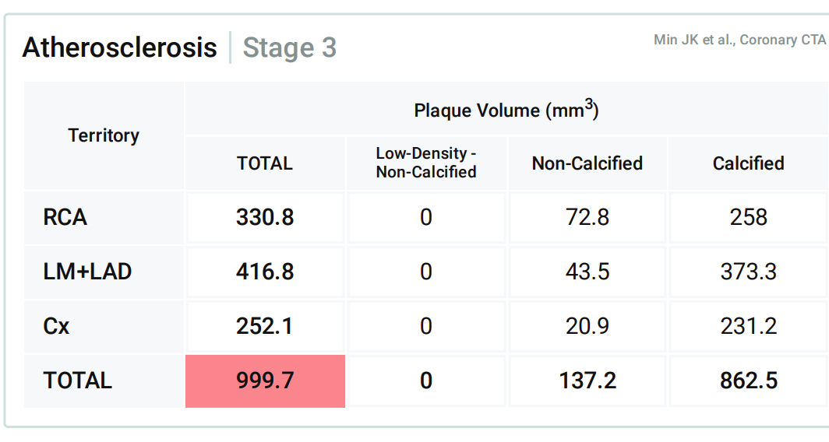
76 M, CAD-stents 2004, 08, 09 and 11
→Treatment for HDL dysfunction—No more symptoms
<
<
<

Slide 57
Fatty
Plaque
Post Rupture
Scar
6 mos→
2yrs
5-10 yrs
10-20 yrs
Notes:
Rick Keister f/u

Slide 58
SA, 52 yo M
High CAC → statins + low carb diet → plant-based diet, stopped statins→ increased CAC→ Cleerly-New Plaque→ return to low carb→statins, PCSK9 inhibitor→repeat Cleerly

Slide 59
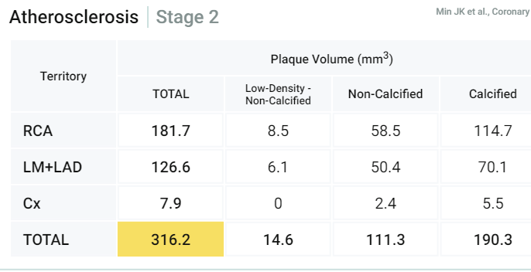
SA, 52 WM, CAC=703
<
<
<

Slide 60
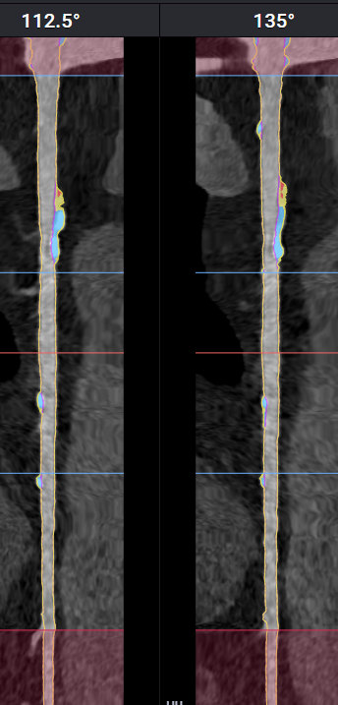

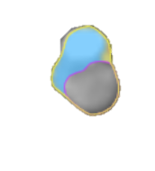
SA , 52, CAC=703,
6/7/24
RCA

Slide 61
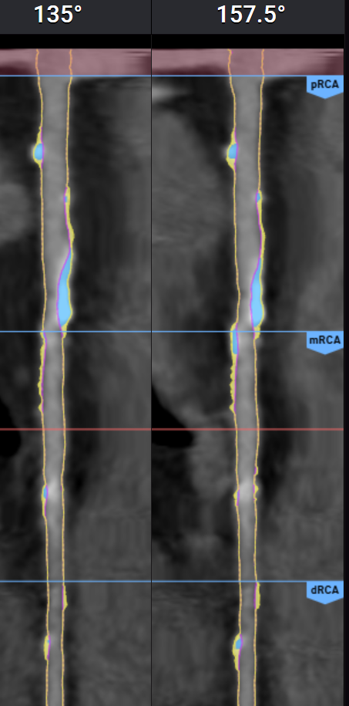
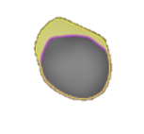
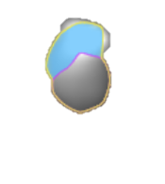
SA , 53, CAC=703,
4/3/25
RCA

Slide 62
Fatty
Plaque
Post Rupture
Scar
6 mos→
2yrs
5-10 yrs
10-20 yrs
Notes:
Rick Keister f/u

Slide 63
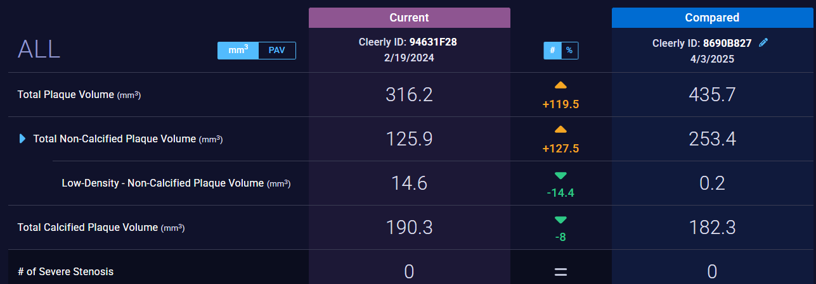
SA 52, CAC=703,

Slide 64
Thank You

Slide 65
END

