Slide 1
From Cath Lab to CcTA-ai: my journey
Joel K. Kahn, MD, FACC
Clinical professor, WSU SOM
Founder, kahn center for cardiac longevity
Michigan and florida

Slide 2
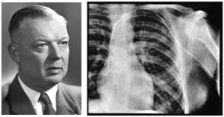
A brief history of coronary angiography

Slide 3
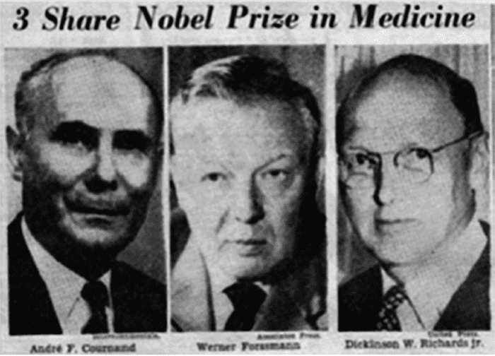
A brief history of coronary angiography

Slide 4
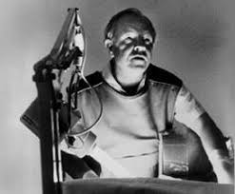
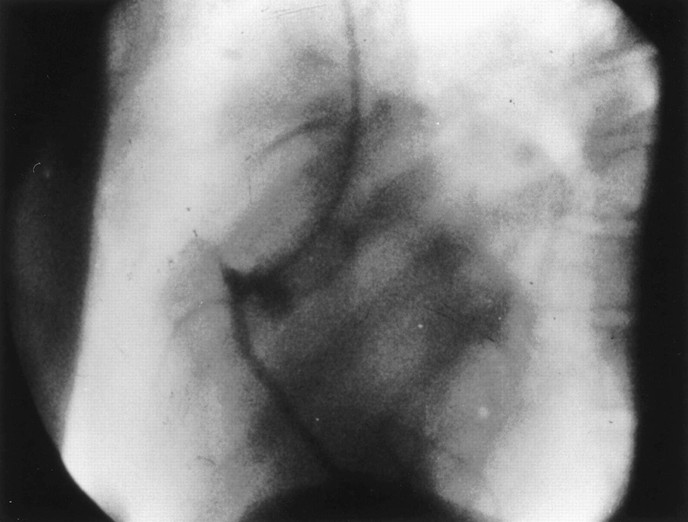
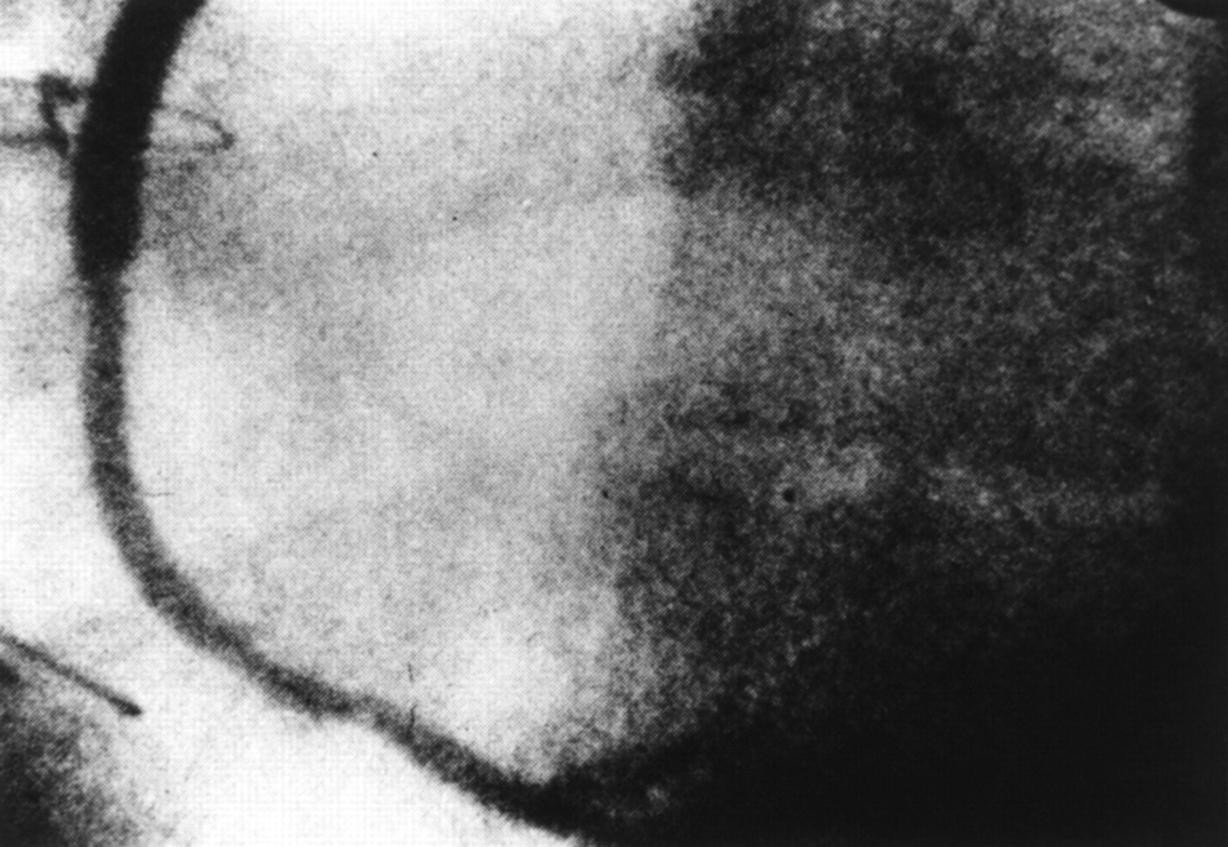
A brief history of coronary angiography

Slide 5
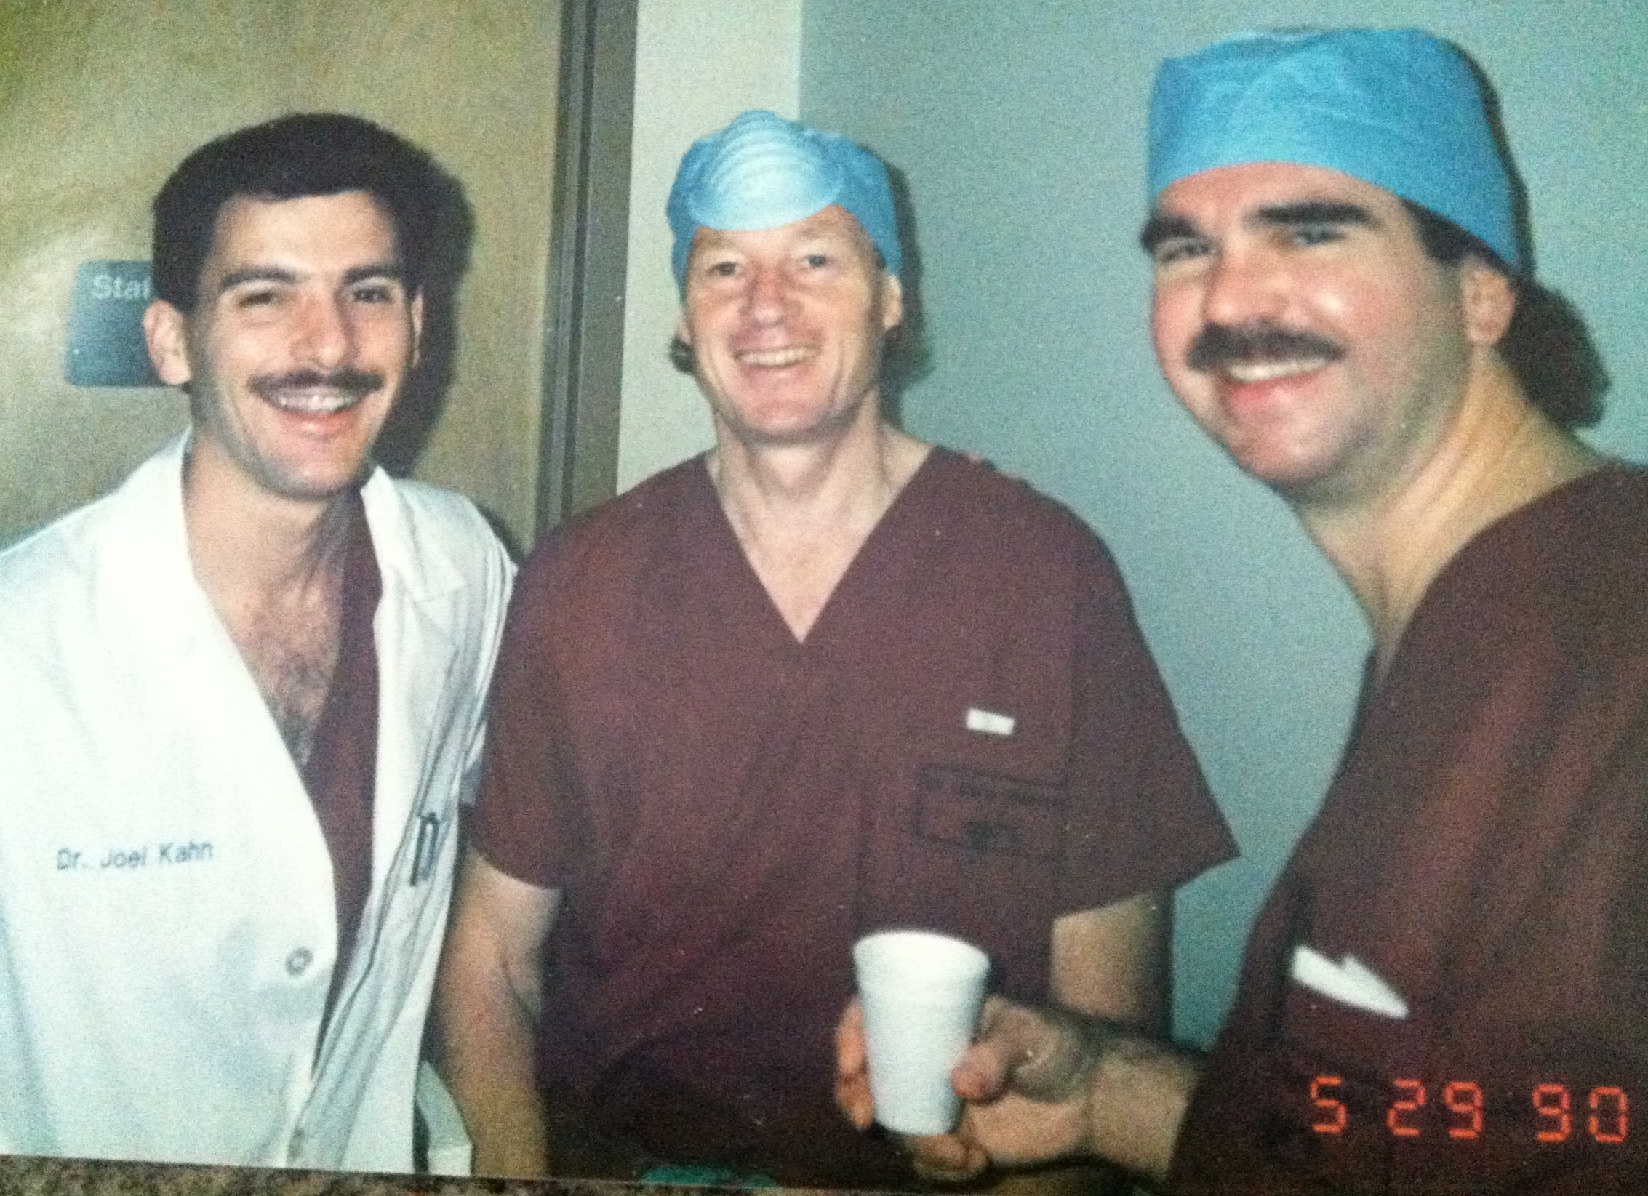
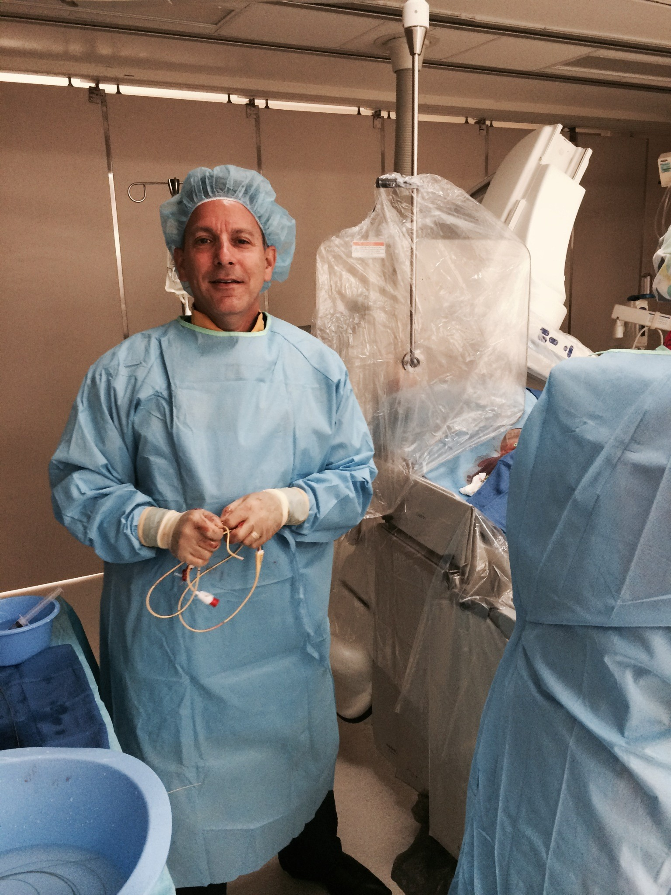
coronary angiography

Slide 6
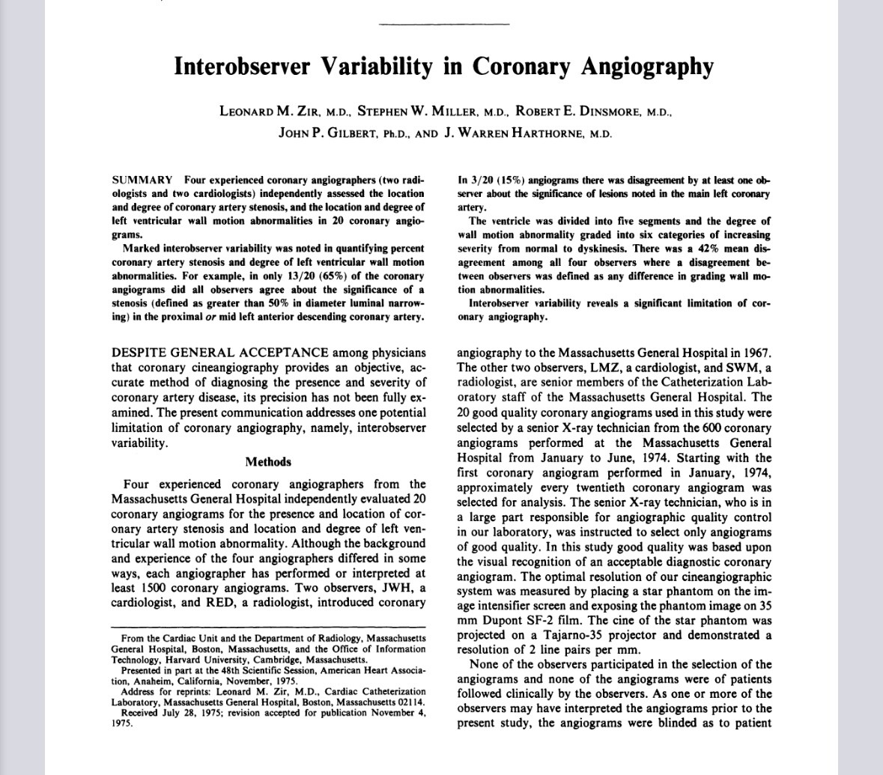
coronary angiography interobserver variability
Zir LM, Miller SW, Dinsmore RE, Gilbert JP, Harthorne JW. Interobserver variability in coronary angiography. Circulation. 1976 Apr;53(4):627-32. doi: 10.1161/01.cir.53.4.627. PMID: 1253383.

Slide 7
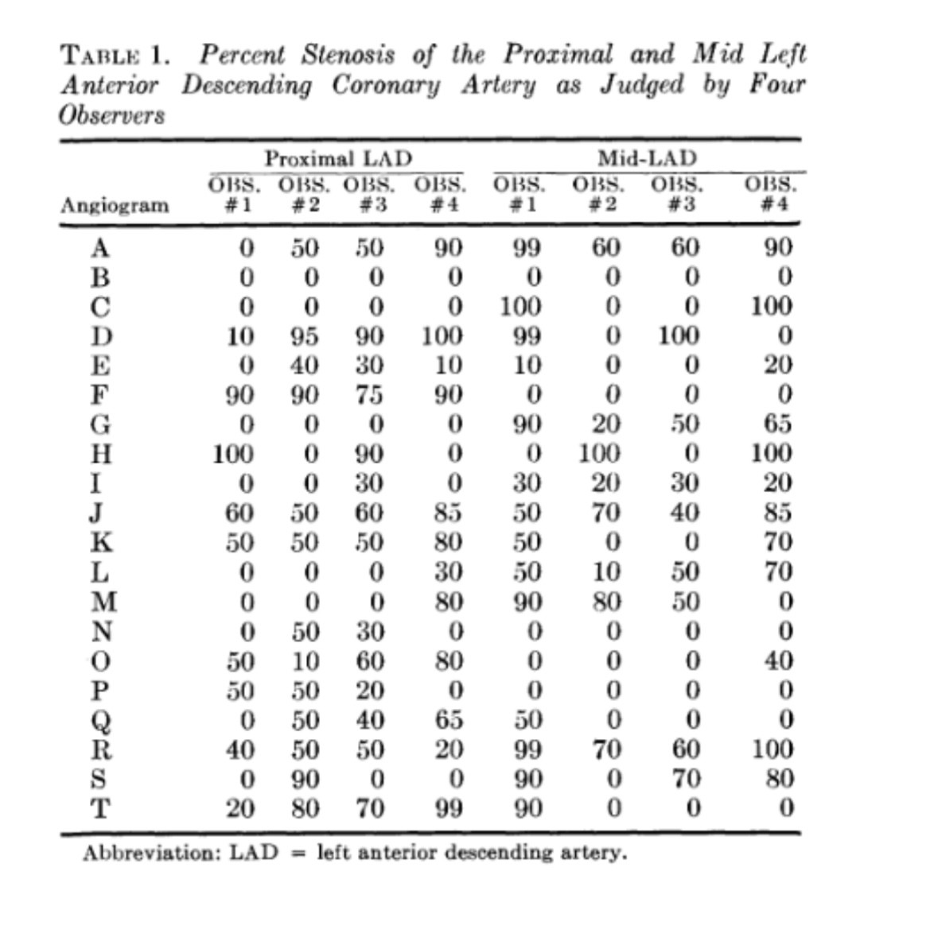
coronary angiography interobserver variability

Slide 8
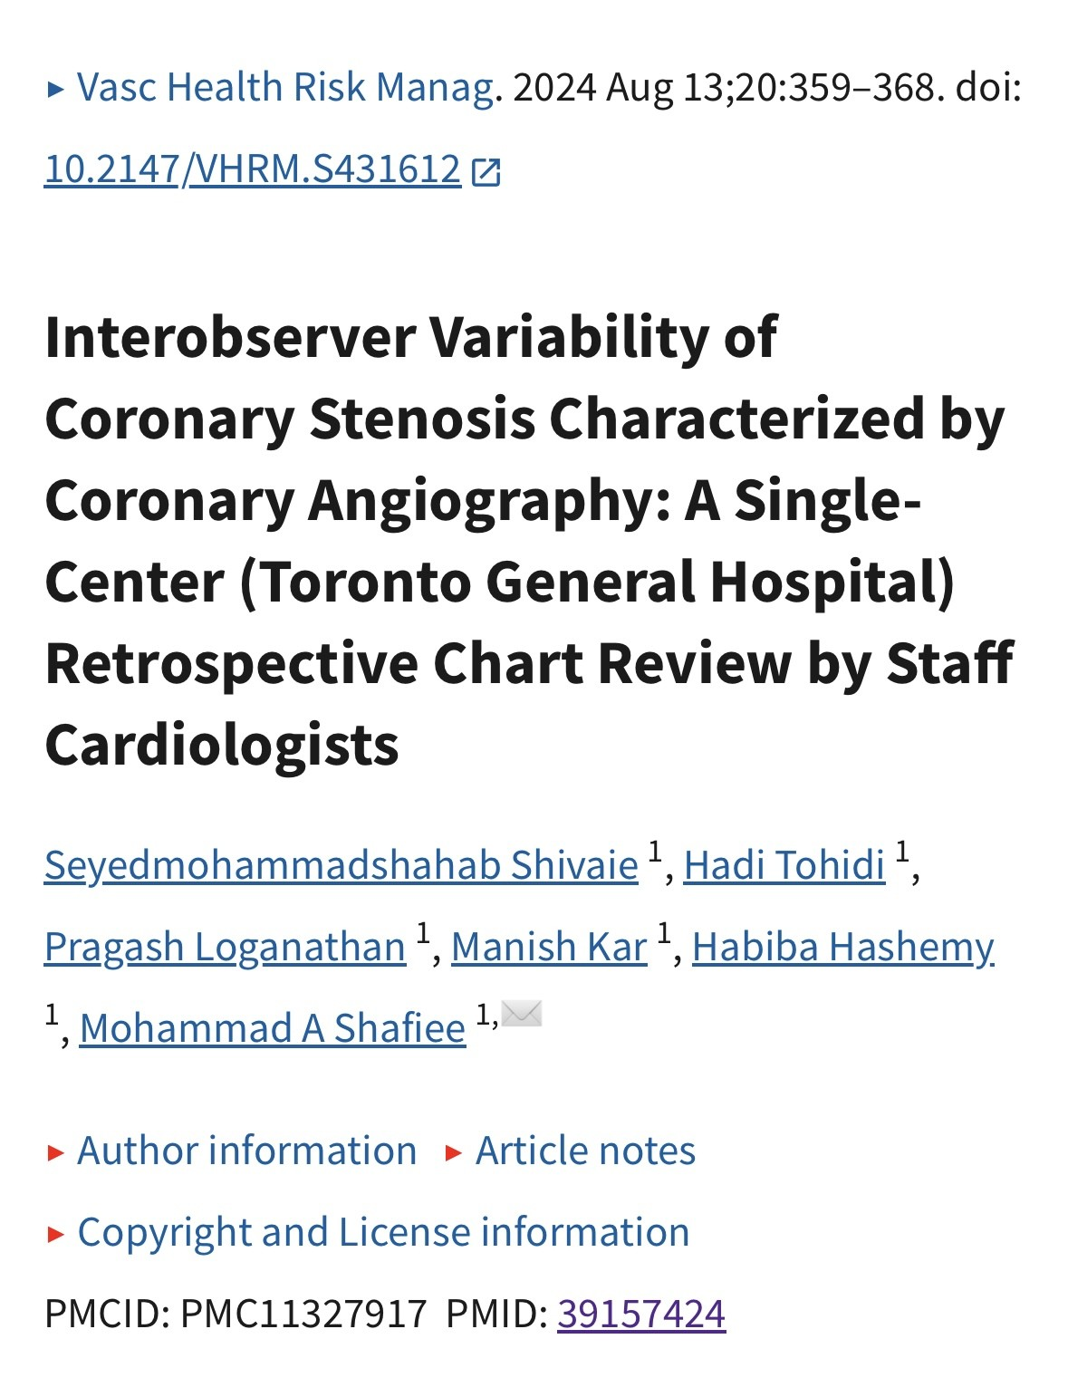
coronary angiography interobserver variability

Slide 9
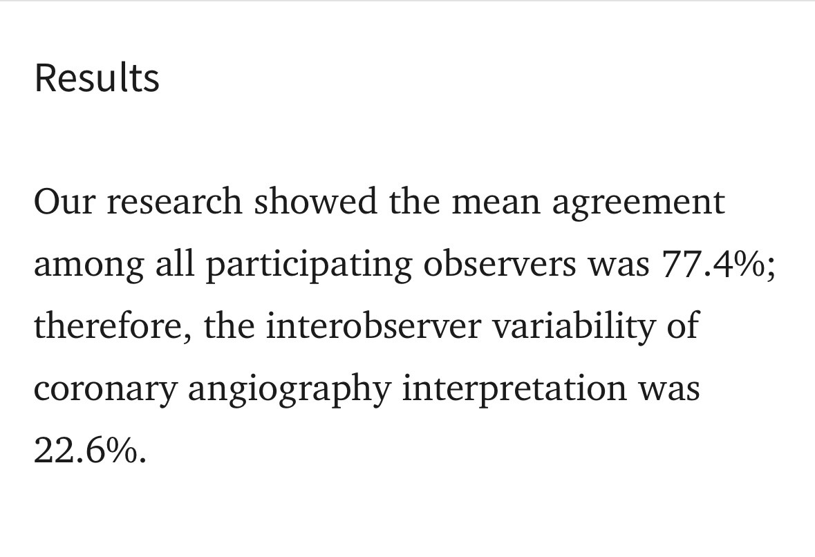
coronary angiography interobserver variability

Slide 10
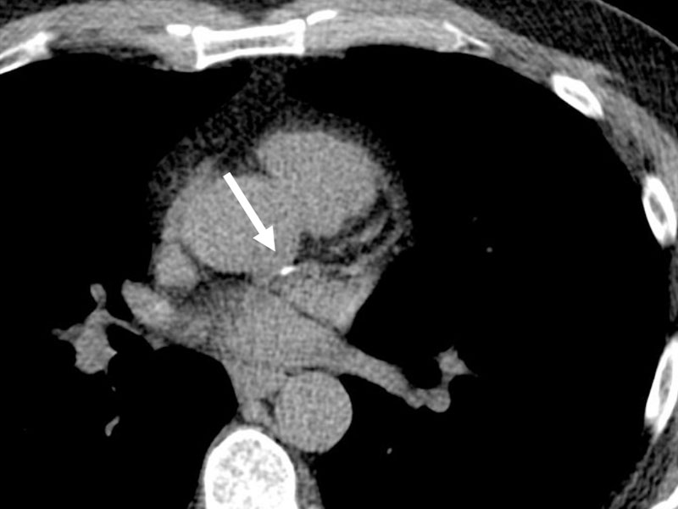
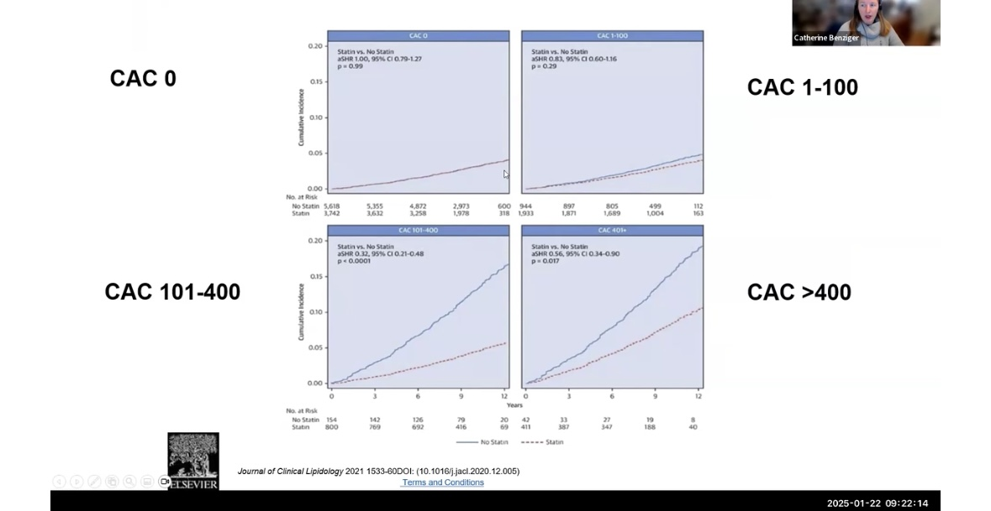
Coronary artery calcium scoring: 1990’s

Slide 11
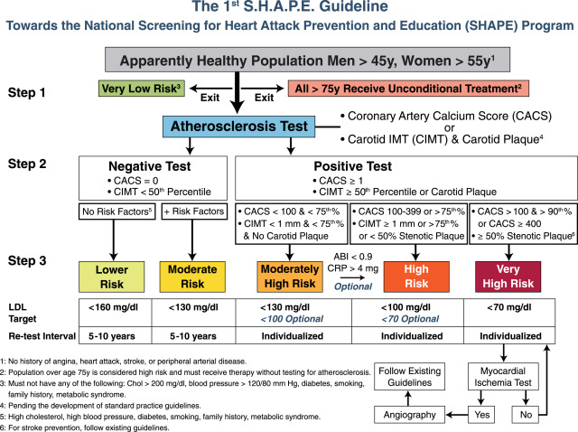
Coronary artery calcium scoring: 2000’s

Slide 12
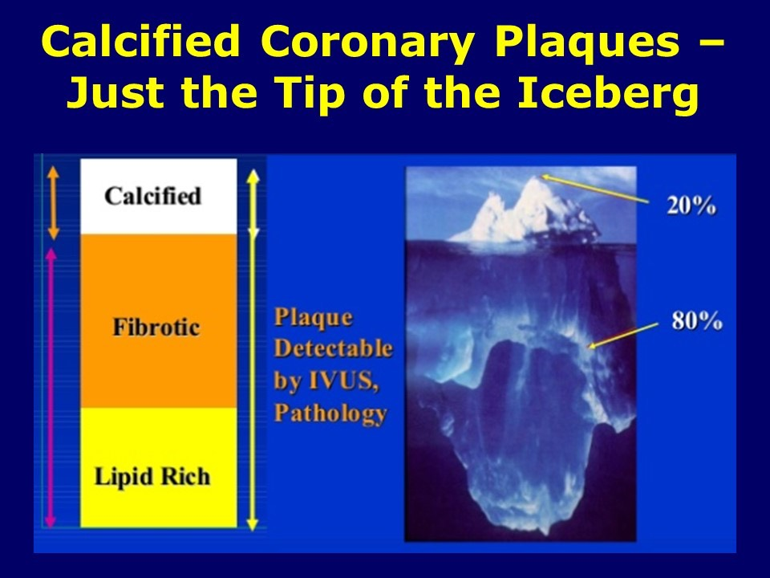
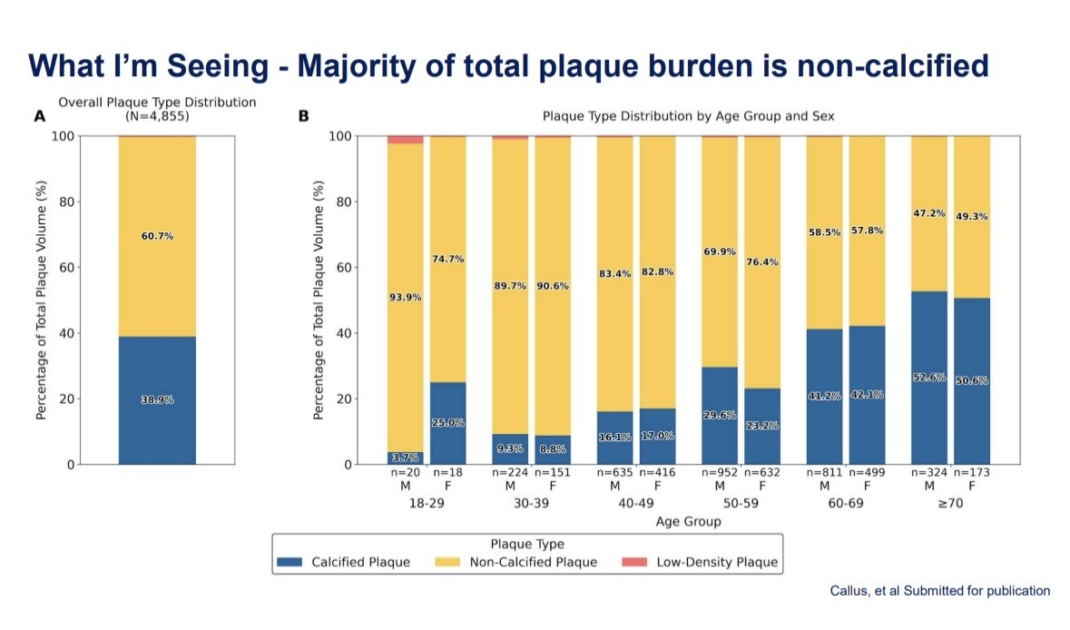
Coronary artery calcium scoring

Slide 13

Coronary ct Angiography with ai plaque analysis and flow measurements

Slide 14
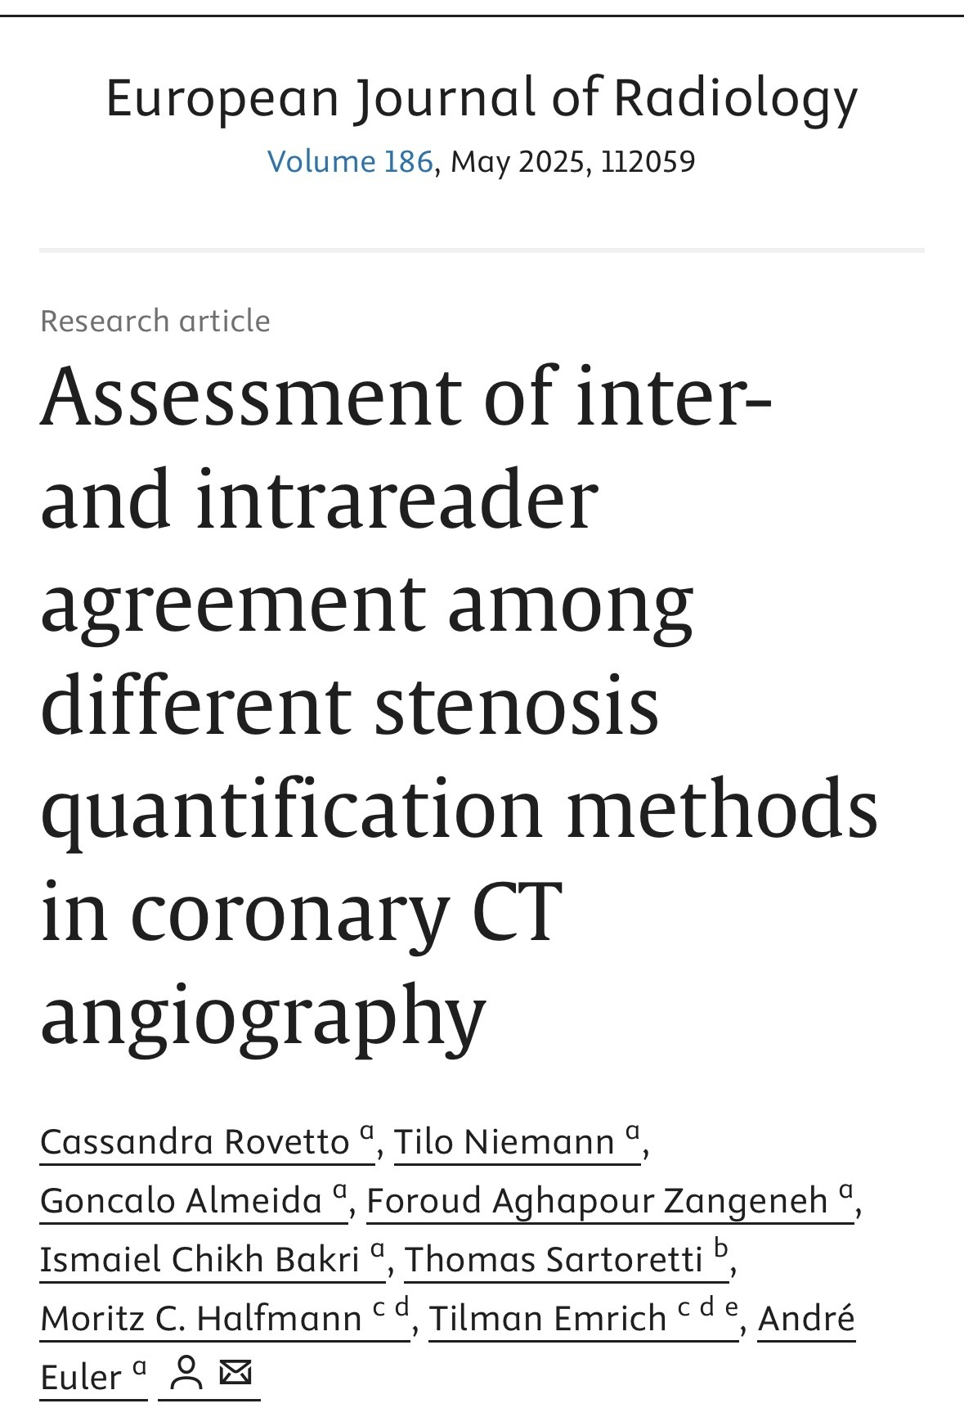
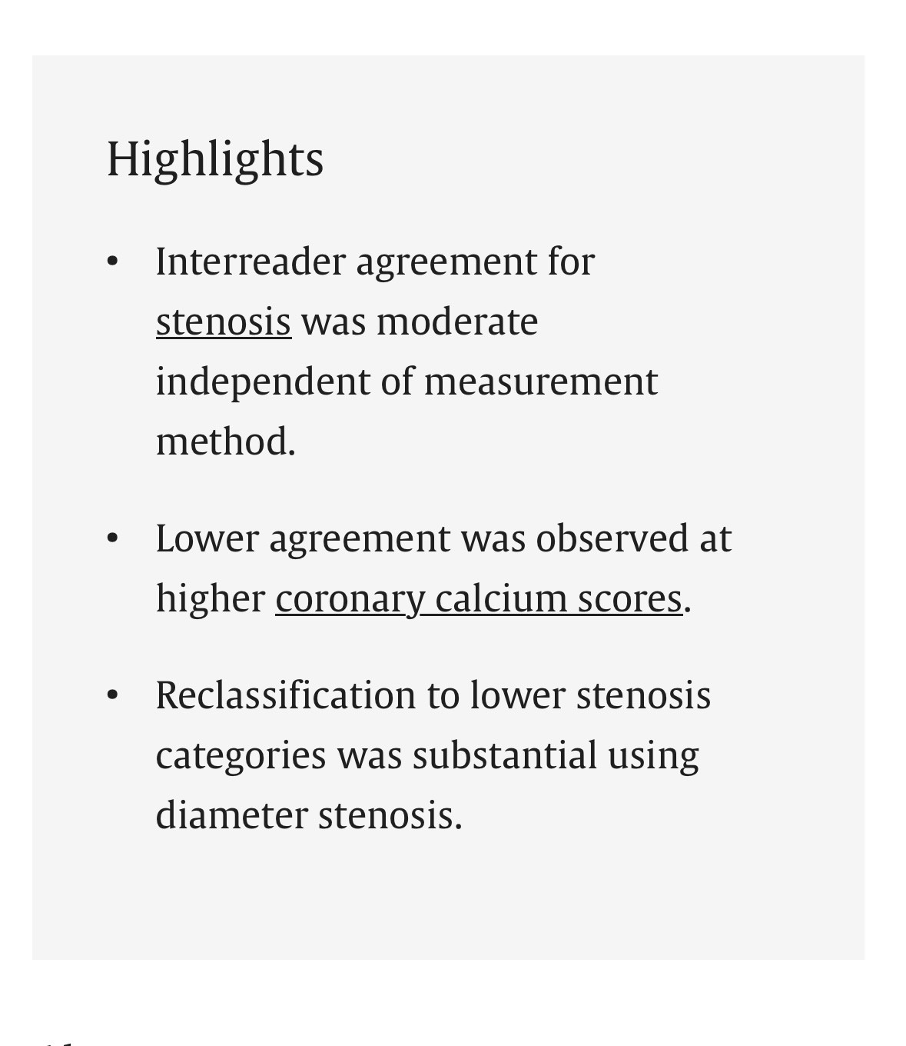
Coronary ct Angiography:
Limitations

Slide 15
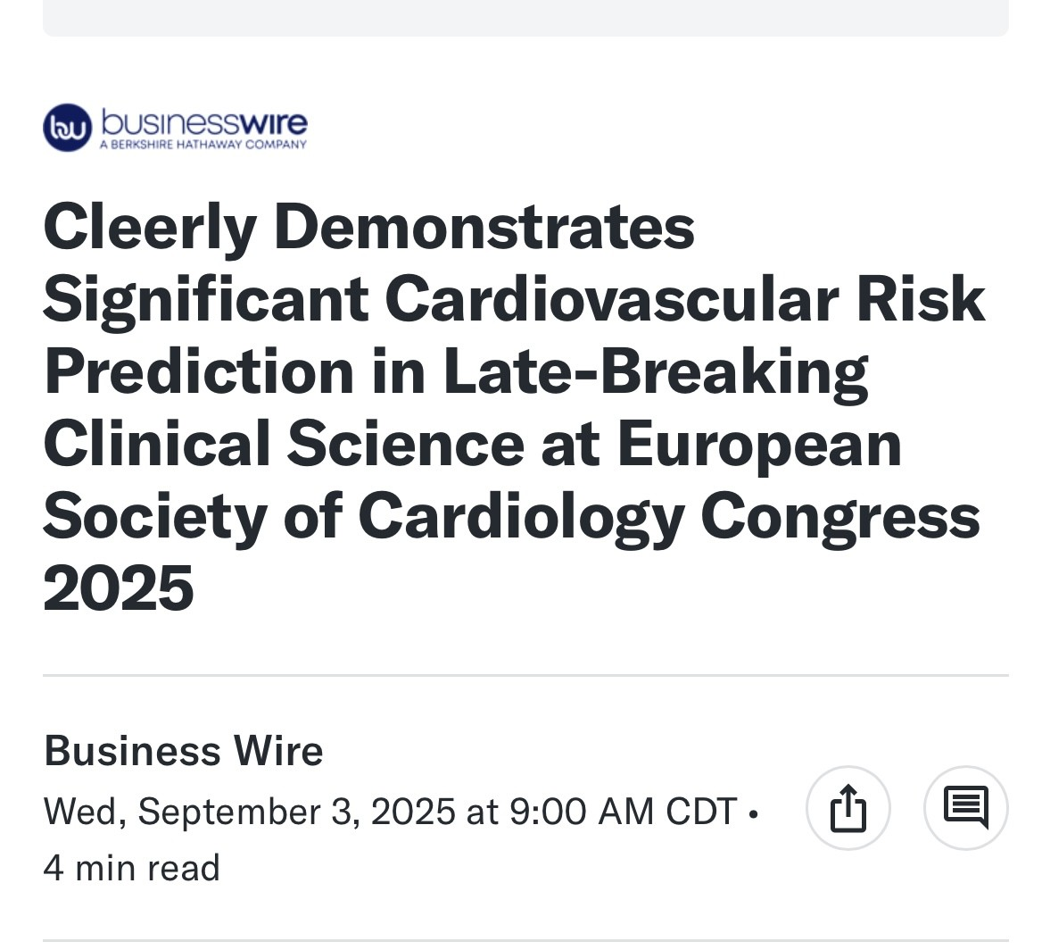
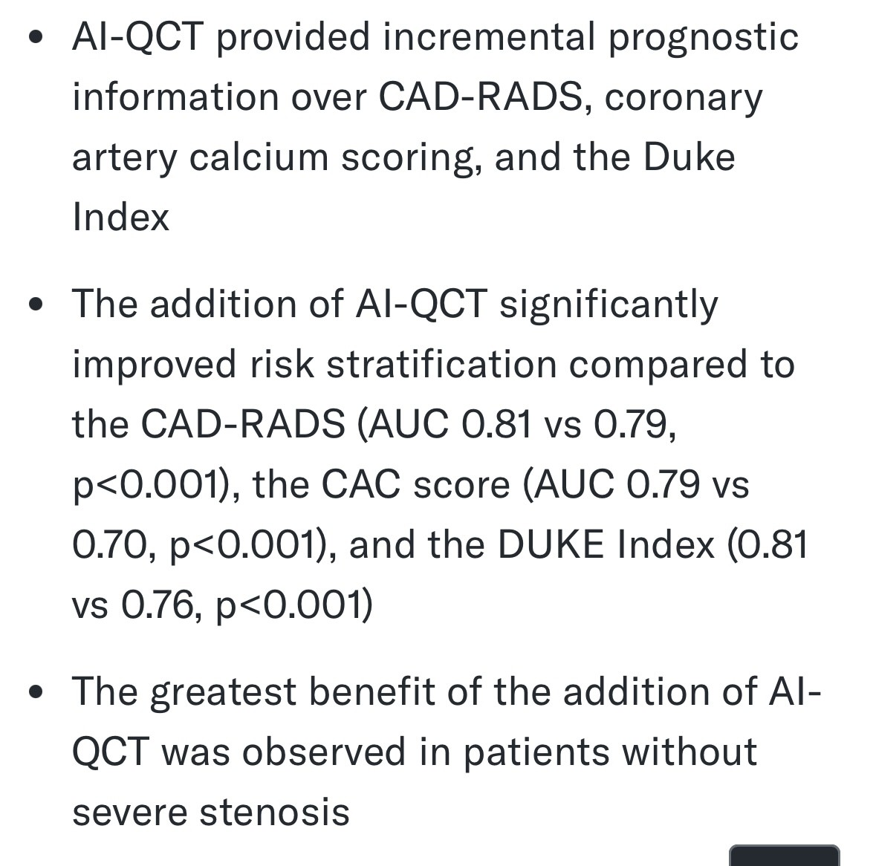
Coronary ct Angiography with ai: Cleerly Data esc 2025

Slide 16
Cleerly AI-QCT: Case study 1
66 yo accountant asymptomatic
2012 cacs of 8
2016 CIMT age 76 at age 52
2018 cacs of 86
Clinic treatment since 2016, atorvastatin 40 mg, ezetimibe 10 mg, telmisartan 40 mg, nattokinase 6,000 FU, Aged Garlic extract
Med plant-forward diet, fitness, sleep

Slide 17
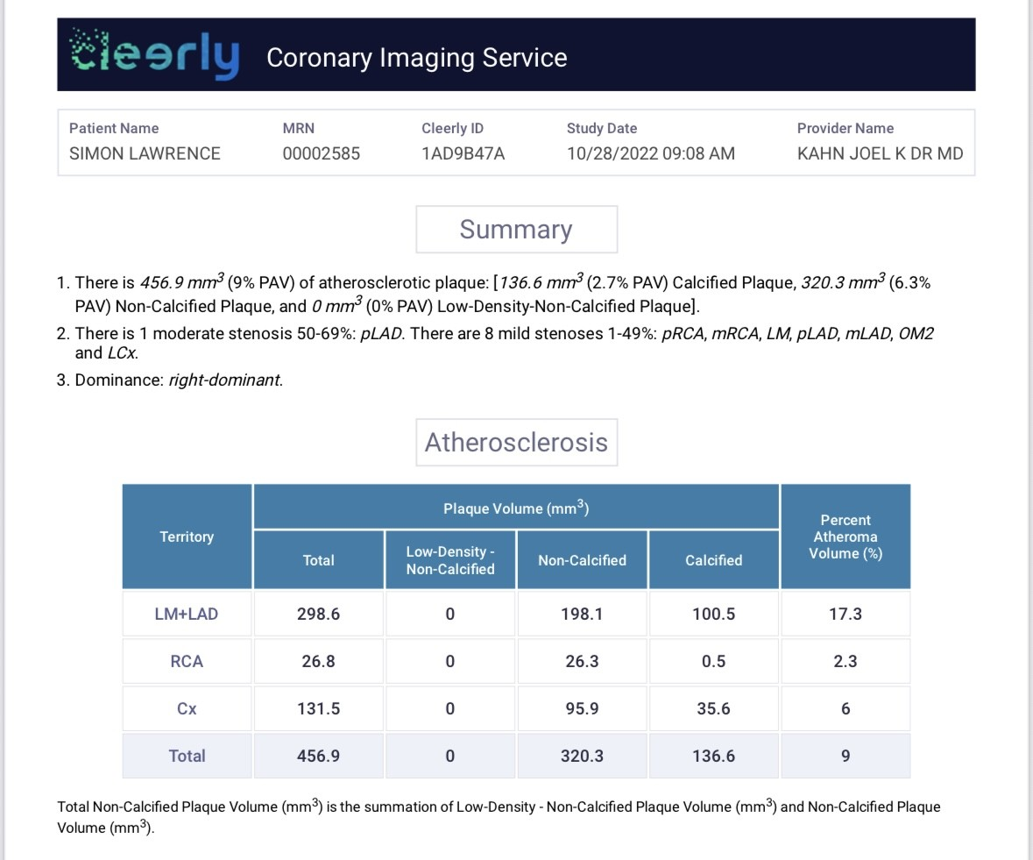
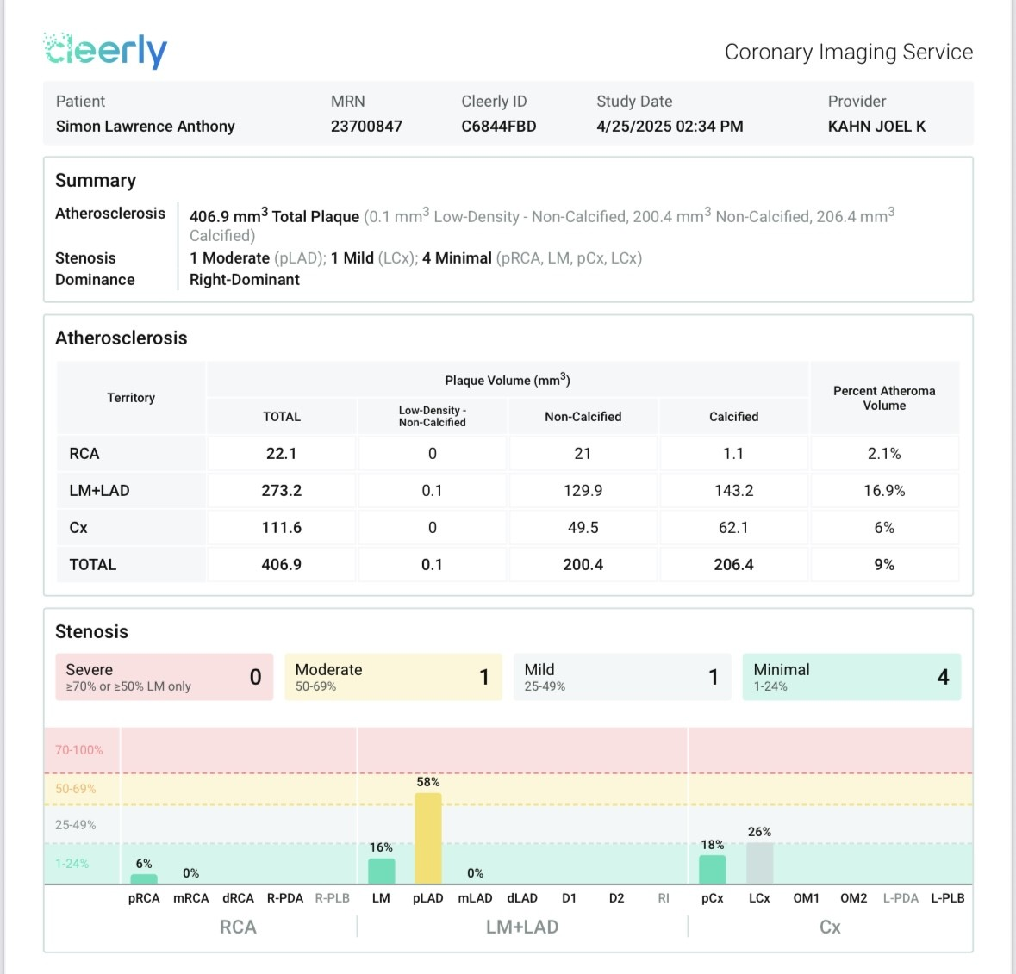
Cleerly AI-QCT: Case study 1

Slide 18
Cleerly AI-QCT: Case study 2
68 yo man
2015 IWMI and stent RCA, mLAD noted 75%, medical therapy
2022 stress mpi without ischemia
Clinic patient since 2022 on “Esselstyn” plant diet, atorvastatin 10 mg, ezetimibe 10 mg, aspirin 81 mg, lisinopril 20 mg, carvedilol 12.5 mg BID
Used rectal b-cyclodextrin 5x a week for 18 months between 2 cleerly scans

Slide 19
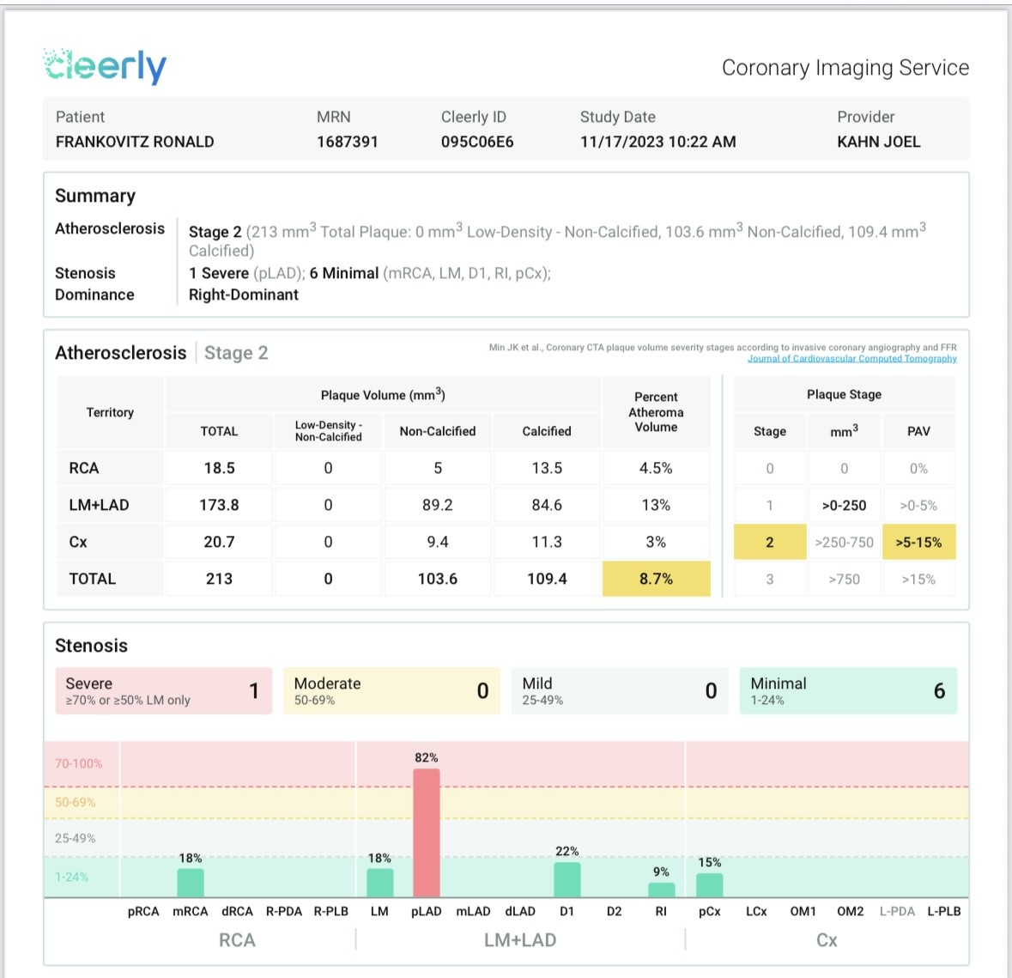
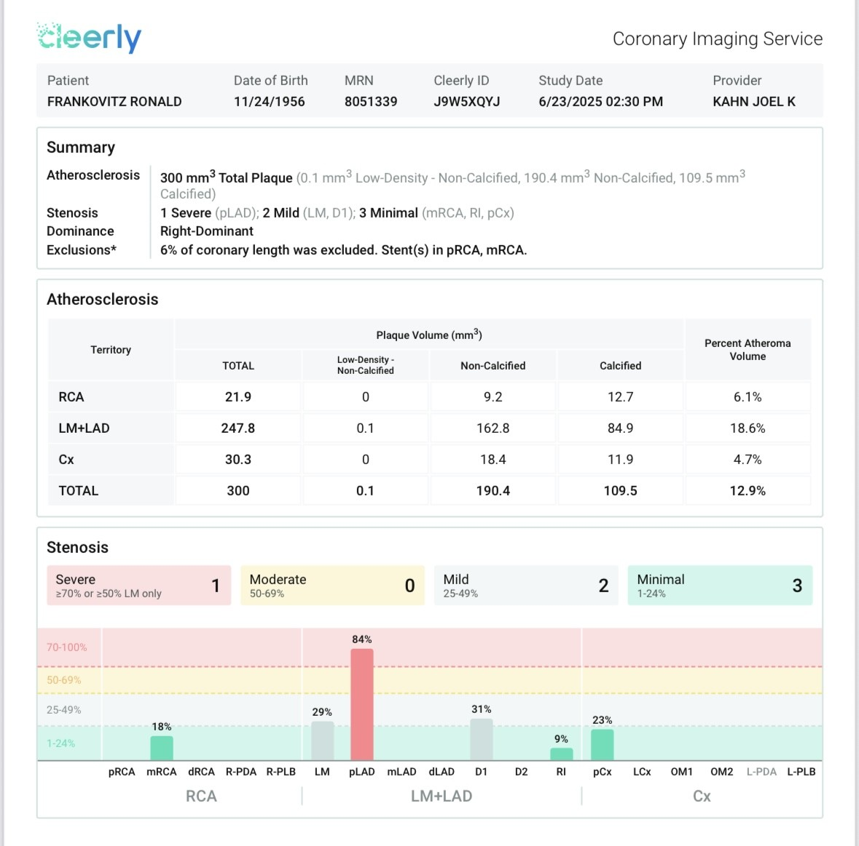
Cleerly AI-QCT: Case study 2
FFR 0.6, CATH 0.55

Slide 20
Cleerly AI-QCT: Case study 3
59 yo tuna fisherman No symptoms
Htn, hl, osa, obesity but 45 lb weight loss to 225 lbs
Recently on aspirin, tirzepatide, metformin, rosuvastatin, ezetimibe, losartan, amlodipine
No diet plan, now med plant-forward diet

Slide 21
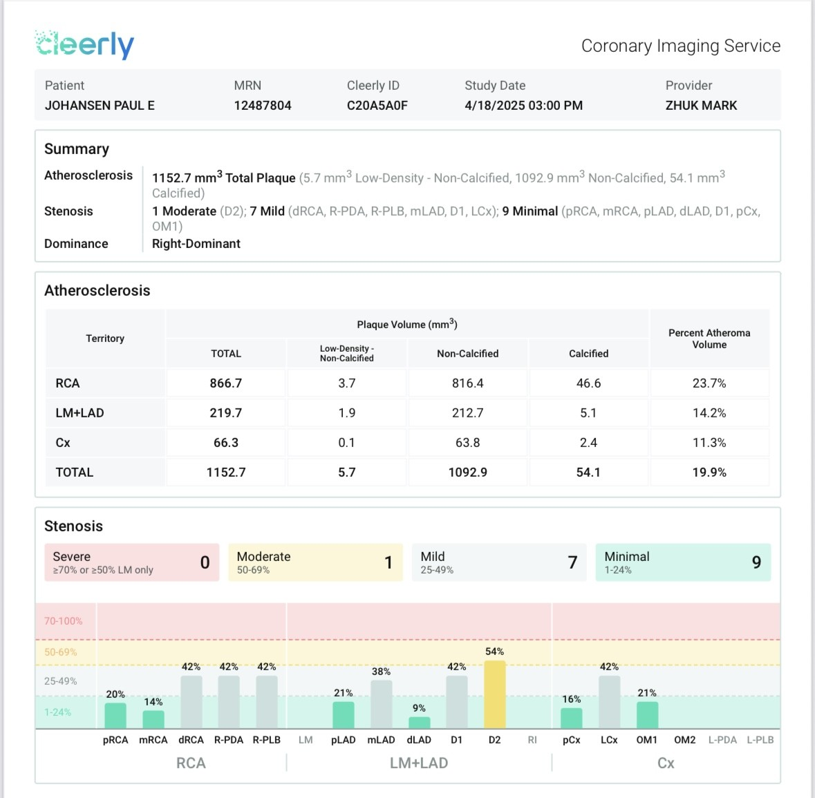
Cleerly AI-QCT: Case study 3

Slide 22
Prognostic Value of AI-based Quantitative Coronary CT Evaluation Versus Standard Qualitative Evaluation (ESC 2025)
Principal investigator Alexander van Rosendael, MD, PhD:
"Plaque burden quantification by AI-QCT provides critical insights that standard CT evaluation will miss, especially in patients with mild to moderate disease who represent a significant portion of our patient population."

Slide 23

The Future is here now

